Slide 1

DriverPass System Analysis
Prepared by: Martin Miranda

Slide 2


System Requirements
Functional Requirements:
The system must allow Customers to register accounts, choose package tiers, and input pickup/drop-off locations for lesson bookings.
The system must allow the Owner and IT Officer to dynamically toggle the status of training packages and block/disable accounts through an administrative control screen.
Nonfunctional Requirements:
Security & Access Control: The system must restrict administrative configurations to authenticated Owner and IT Officer credentials via role-based access tokens.
Data Integrity & Consistency: The database must use strict transaction isolation controls to prevent double-booking of a single instructor or vehicle slot during concurrent scheduling traffic.

Slide 3
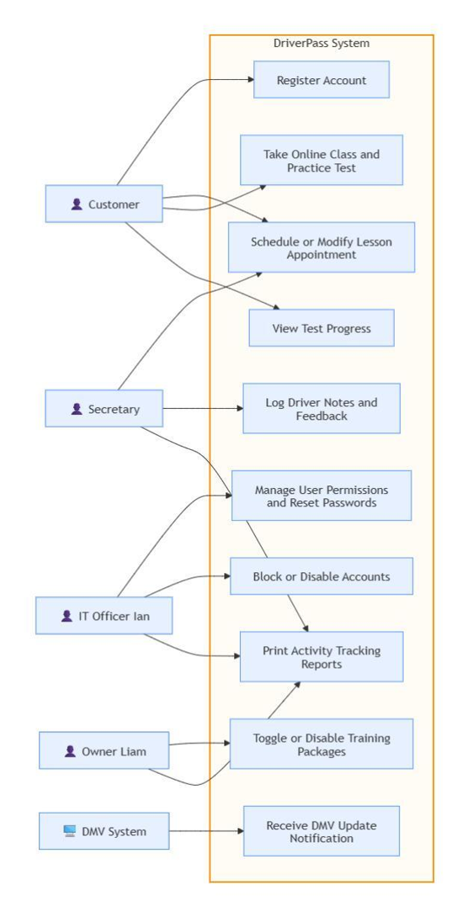
Use Case Diagram

Slide 4
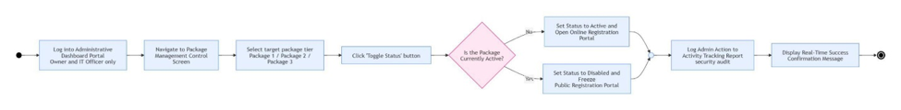
Activity Diagram

Slide 5
Security
Network Encryption: Employs mandatory HTTPS data paths secured via modern SSL/TLS certificates to safeguard personal information and credentials during transit.
Role-Based Access Control (RBAC): Integrates secure OAuth 2.0/OpenID Connect layers to strictly segment roles, locking out standard customers or secretaries from administrative interfaces.
Immutable Audit Trails: Deploys a dedicated centralized log storage layer (such as the ELK Stack) to register and protect security audit logs every time an administrator modifies packages or alters user privileges.

Slide 6
System Limitations
External Dependency Risk: System tracking updates are directly dependent on the availability and uptime of the third-party DMV System API endpoint.
Manual Asset Overrides: While the software perfectly optimizes digital resource allocation (verifyAvailability), it remains dependent on human entries for structural edge-cases like unexpected physical vehicle maintenance delays or sudden instructor leave.
No In-App Native Payment Gateway: The architecture relies on structural package credit balances and deductions rather than managing direct bank or card merchant clearing logic directly on the portal.

